Slide 1
ThankYou!

Slide 2
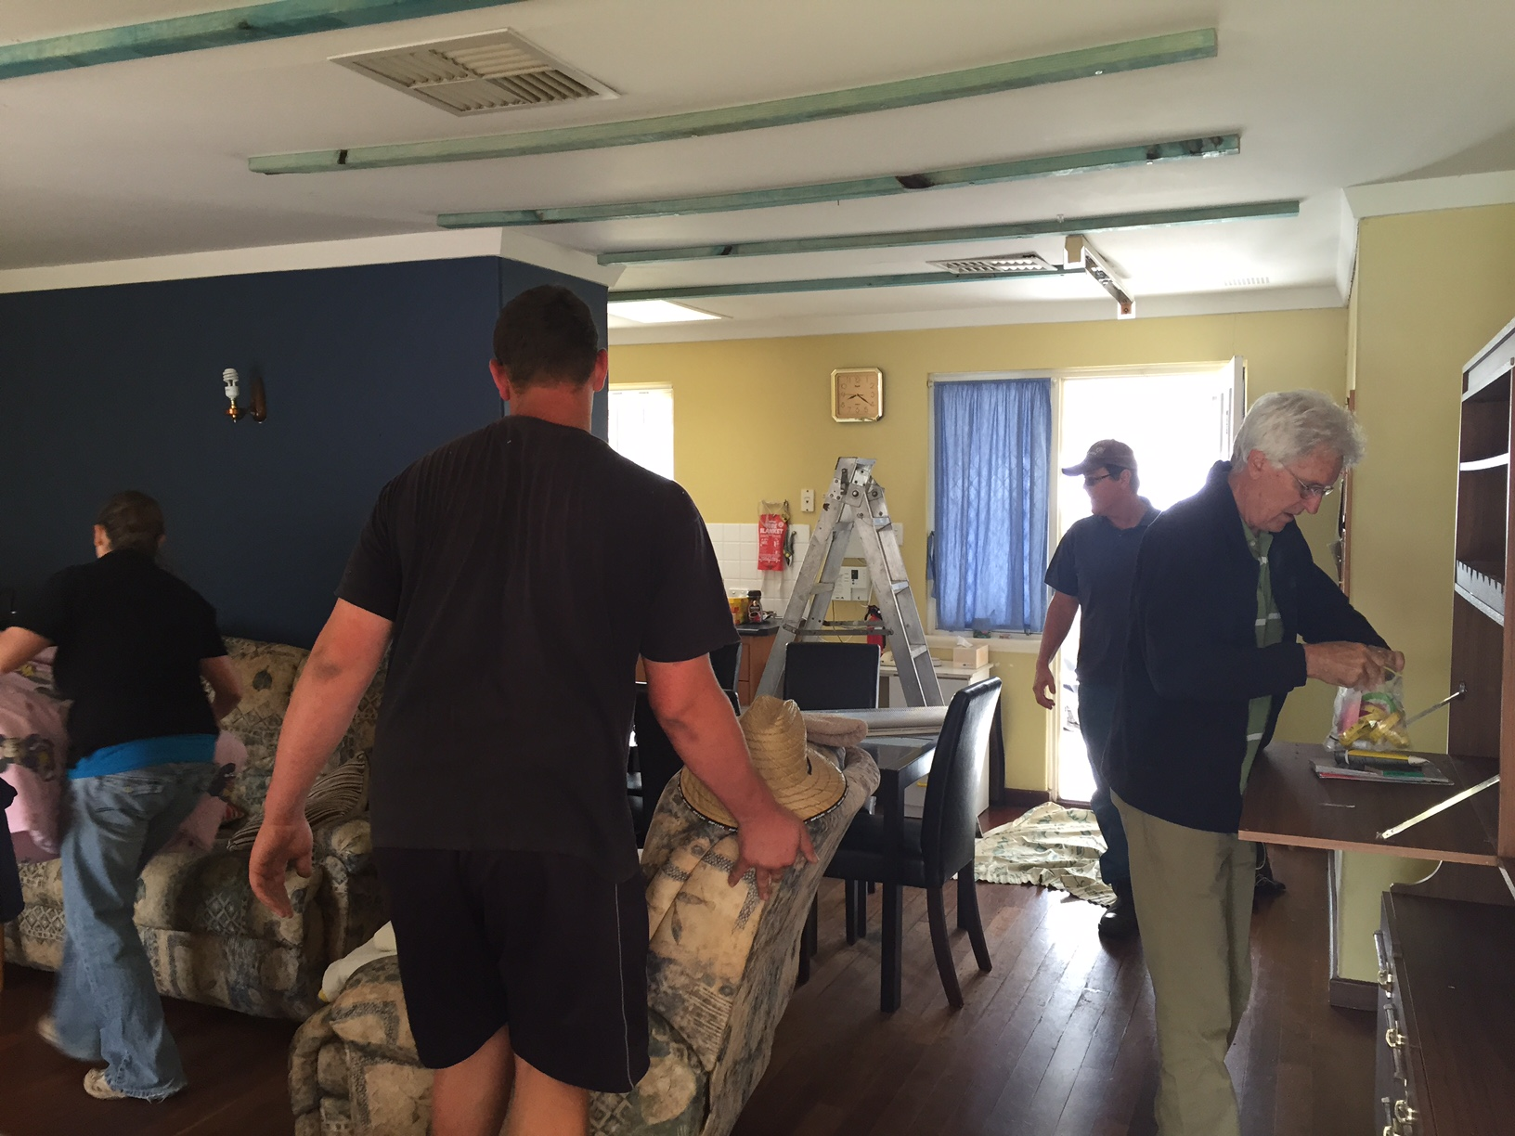
2015

Slide 3
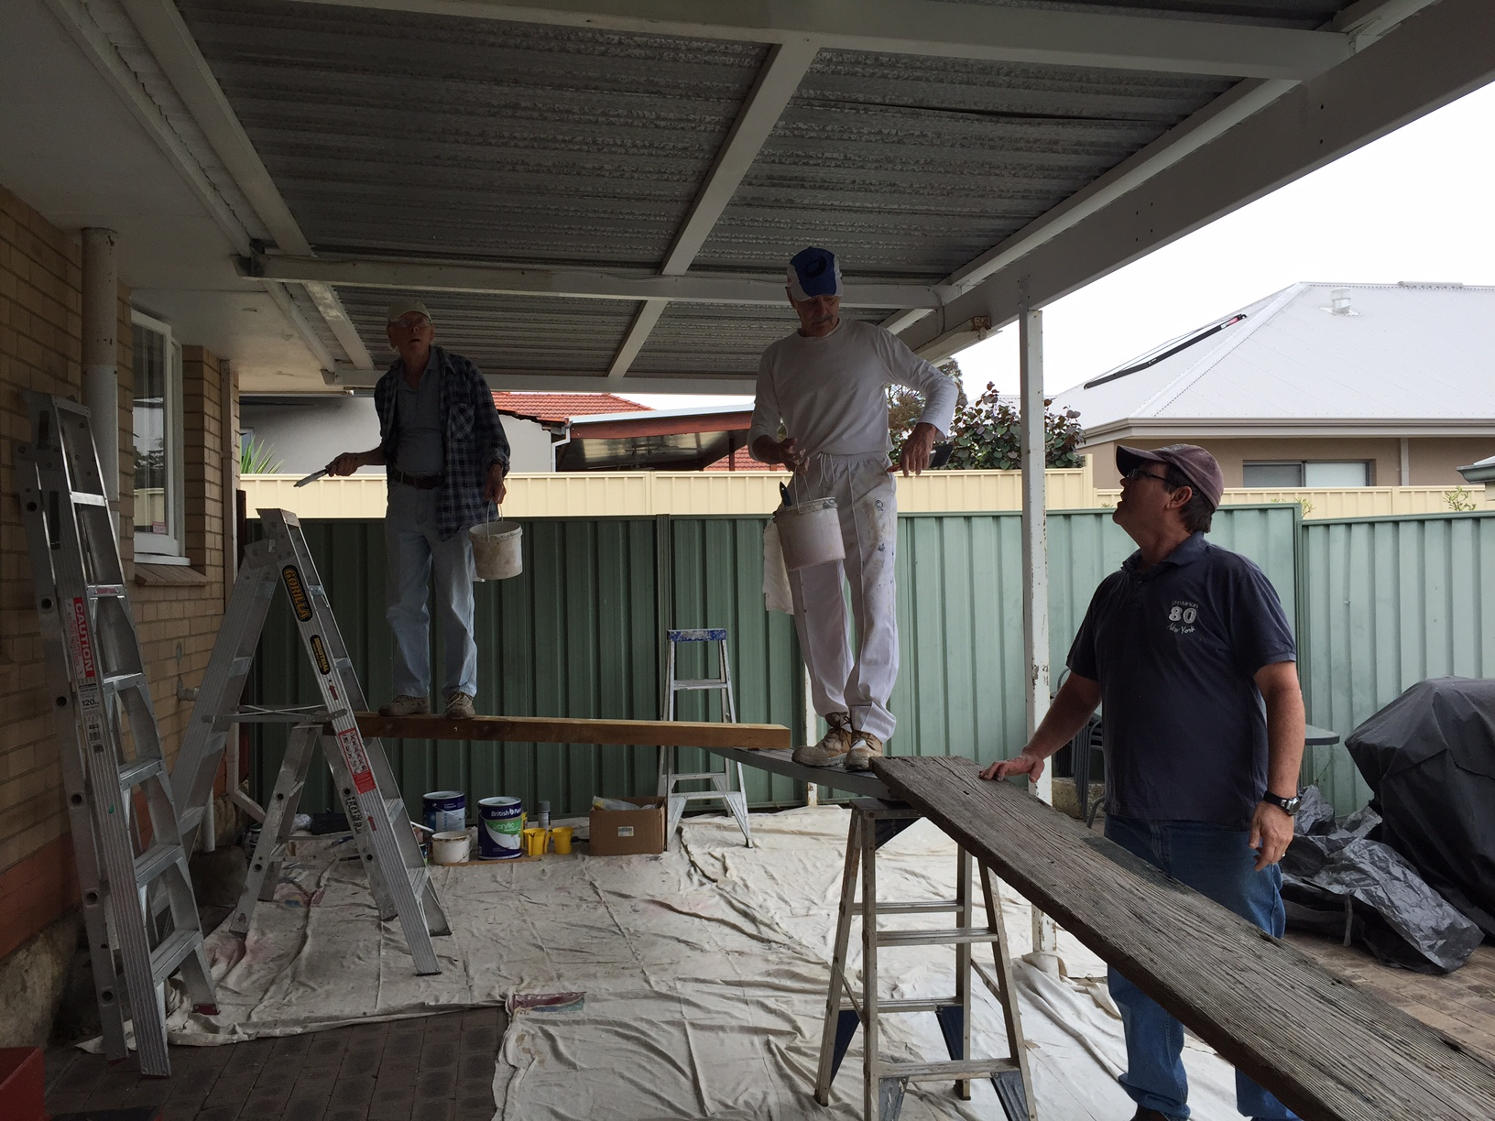
2015

Slide 4
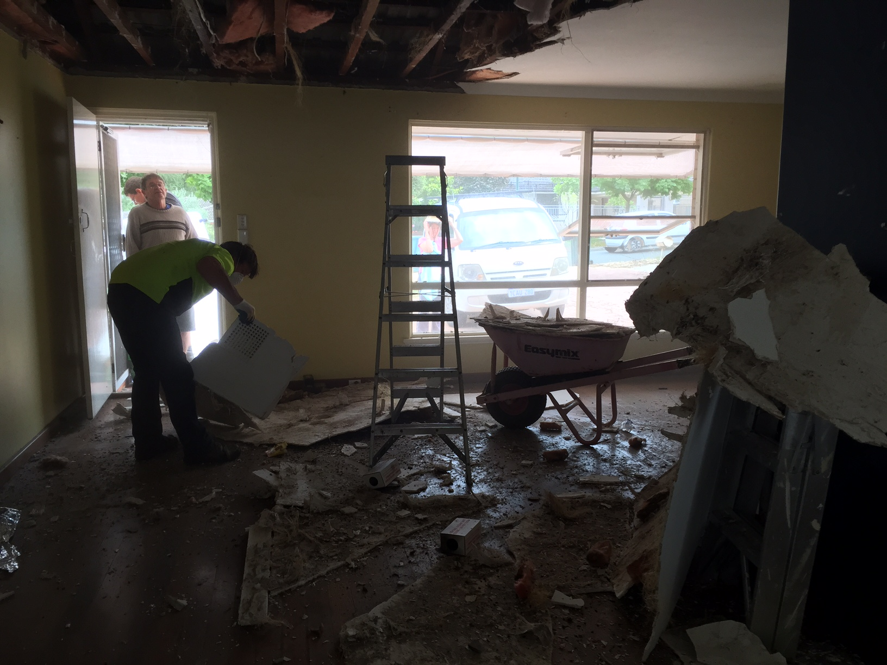
2015

Slide 5
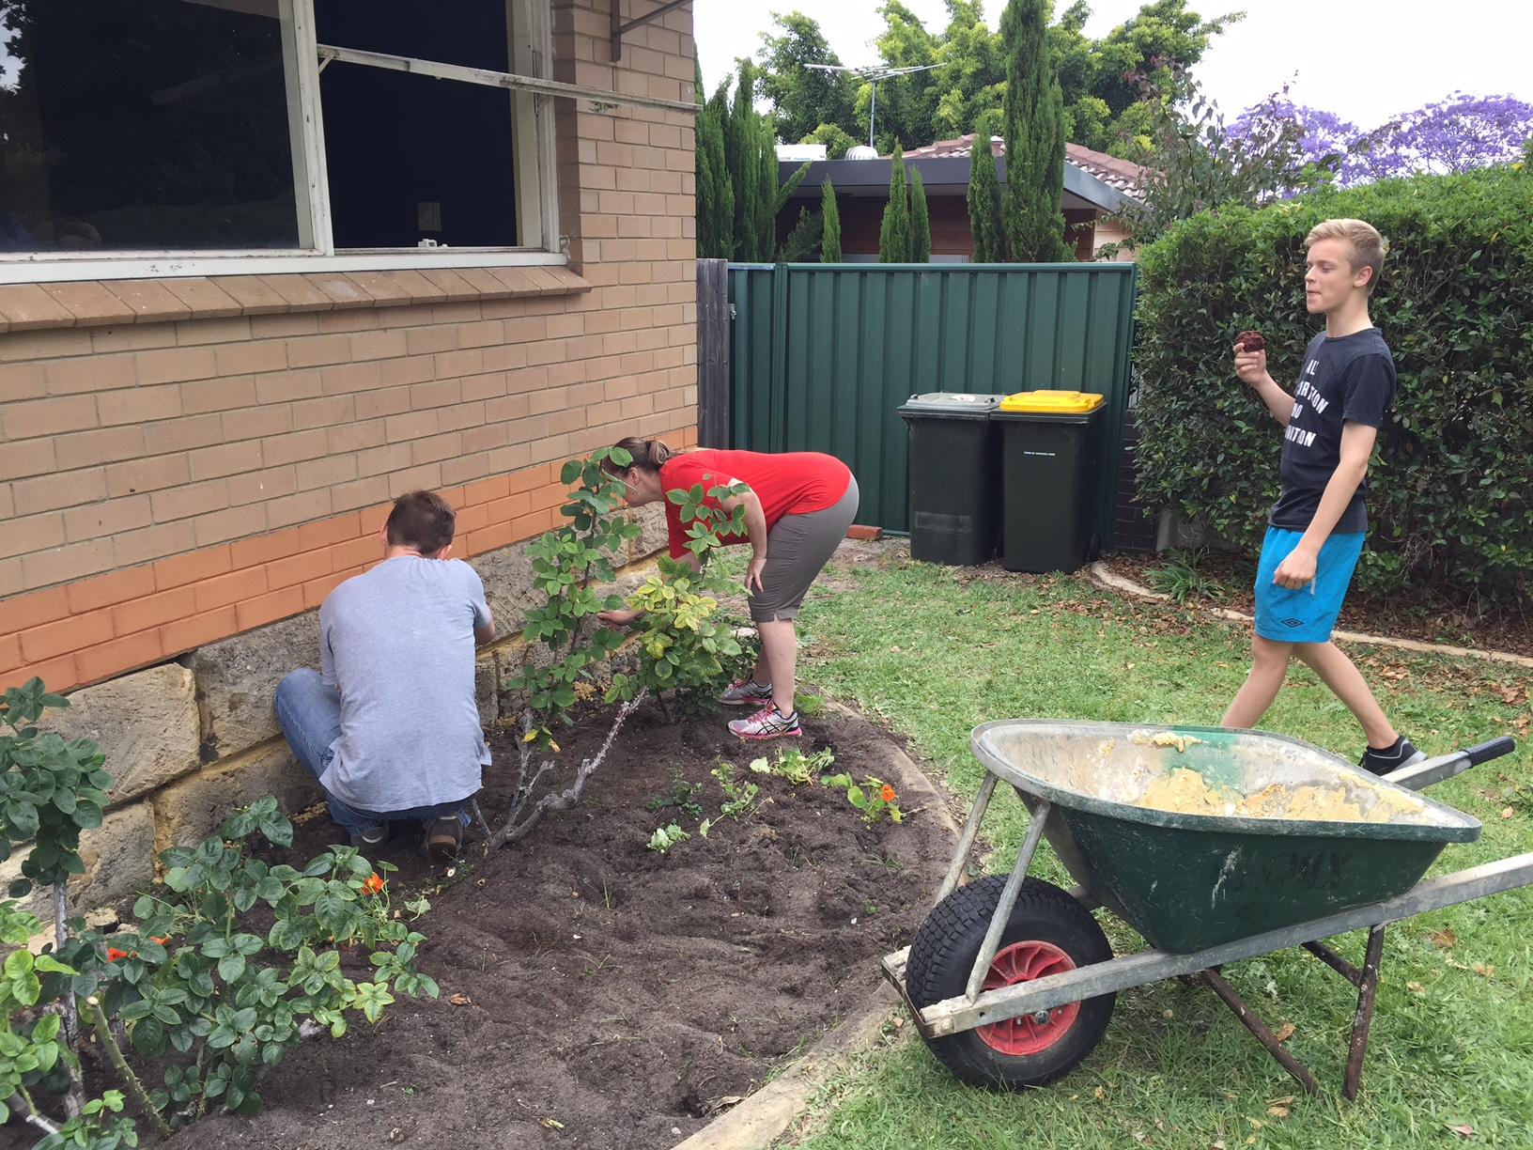
2015

Slide 6
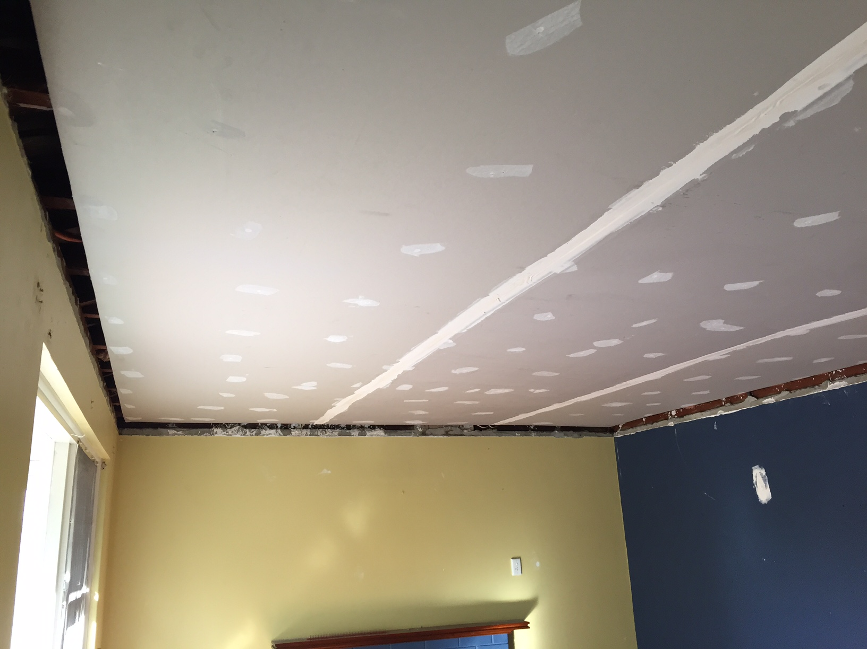
2015

Slide 7
ThankYou!

Slide 9
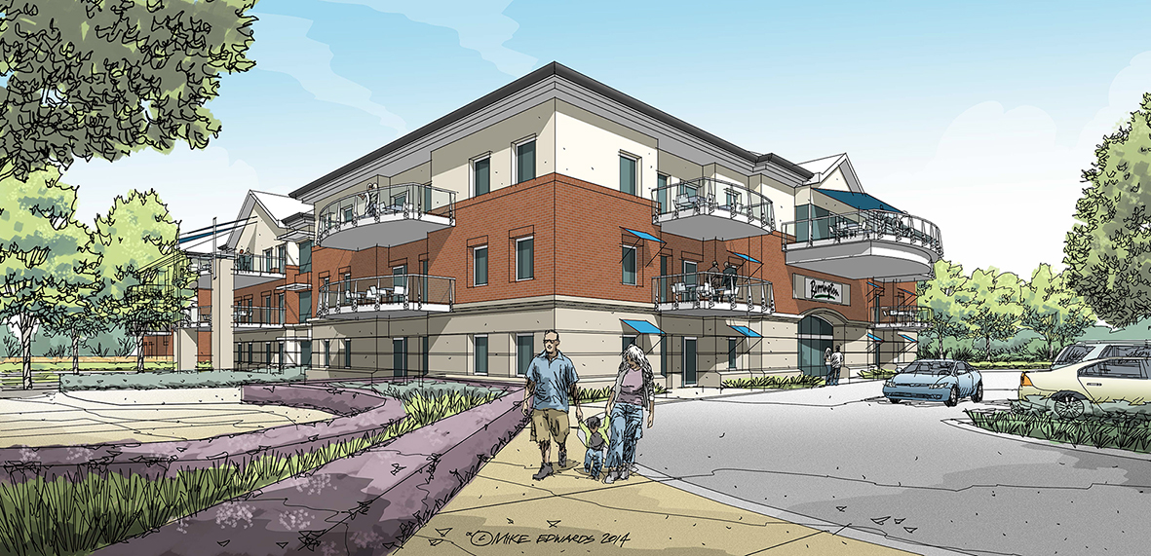
Berrington Aged Care Facility

Slide 10
Car Park Redevelopment

Slide 11
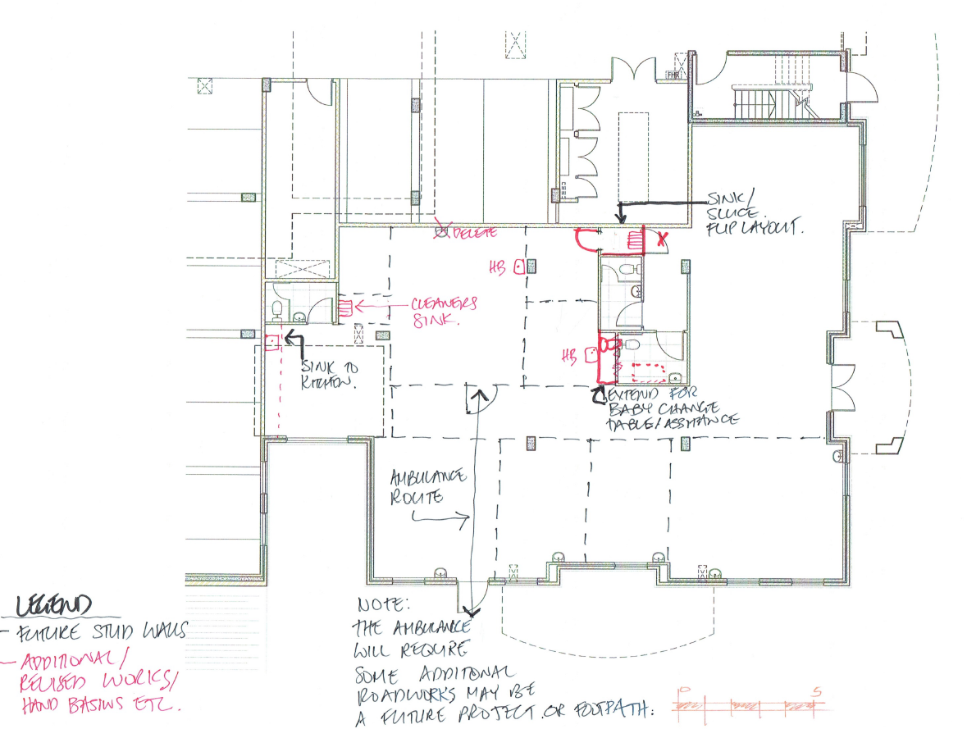
Lifestreams Health Care Centre

Slide 12
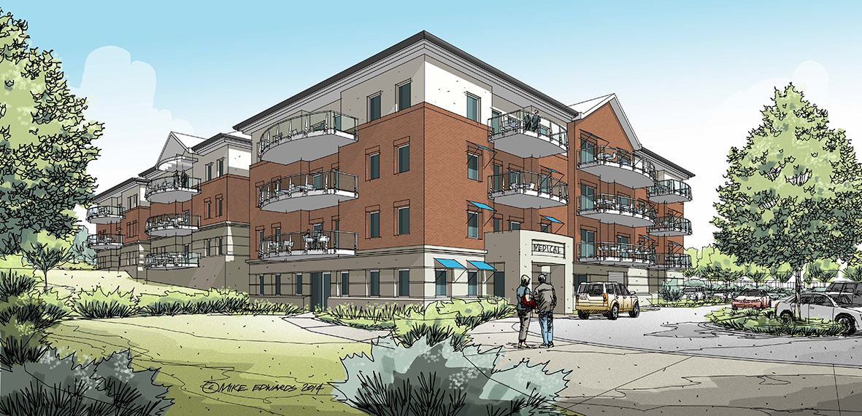
Lifestreams Health Care Centre
Information Afternoon
Sunday 15th of November 4.00pm in the Church Cafe

Slide 13
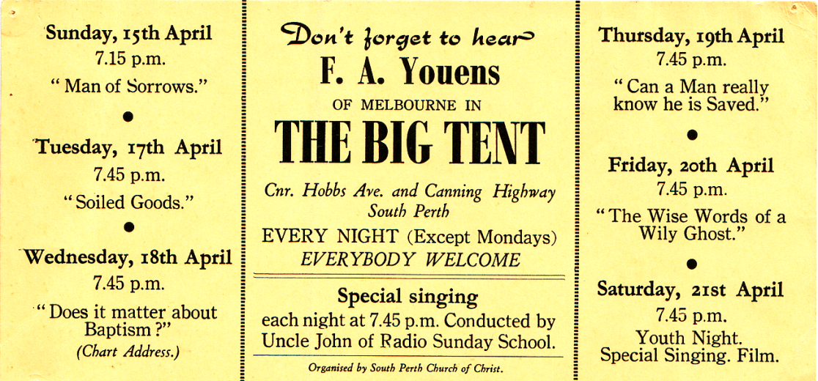
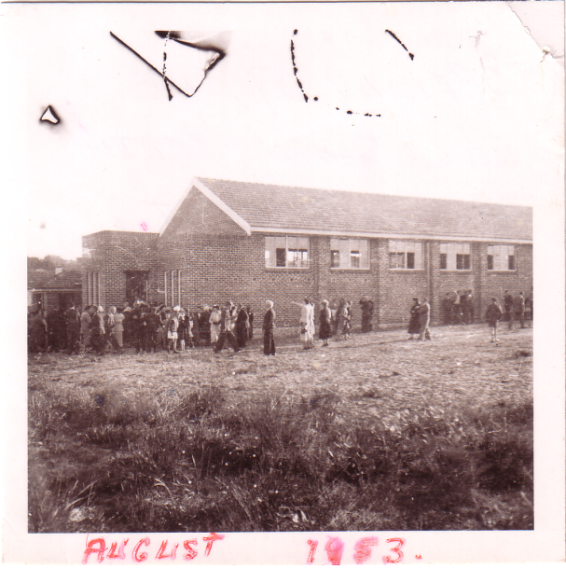
Lifestreams Christian Church is 68 Years Old…

Slide 14
Philippians 1
3-6 Every time you cross my mind, I break out in exclamations of thanks to God. Each exclamation is a trigger to prayer. I find myself praying for you with a glad heart. I am so pleased that you have continued on in this with us, believing and proclaiming God’s Message, from the day you heard it right up to the present. There has never been the slightest doubt in my mind that the God who started this great work in you would keep at it and bring it to a flourishing finish on the very day Christ Jesus appears.

Slide 15
Philippians 1
7-8 It’s not at all fanciful for me to think this way about you. My prayers and hopes have deep roots in reality. You have, after all, stuck with me all the way from the time I was thrown in jail, put on trial, and came out of it in one piece. All along you have experienced with me the most generous help from God. He knows how much I love and miss you these days. Sometimes I think I feel as strongly about you as
Christ does!

Slide 16
Philippians 1
9-11 So this is my prayer: that your love will flourish and that you will not only love much but well. Learn to love appropriately. You need to use your head and test your feelings so that your love is sincere and intelligent, not sentimental gush. Live a lover’s life, circumspect and exemplary, a life Jesus will be proud of: bountiful in fruits from the soul, making Jesus Christ attractive to all, getting
everyone involved in the glory and praise of God.

Slide 17
Thank you!

